Slide 1



IoT Based Smart
Agriculture System
JAMIA MILLIA ISLAMIA
DEPARTMENT OF ELECTRICAL ENGINEERING
By - Anash Khan 19BEE025
Mohammad Adnan 19BEE029
Mohd Fahad 19BEE031
Under the guidance of:-
Dr. Ahtesham ul Haque (D/o Electrical Engineering)

Slide 2
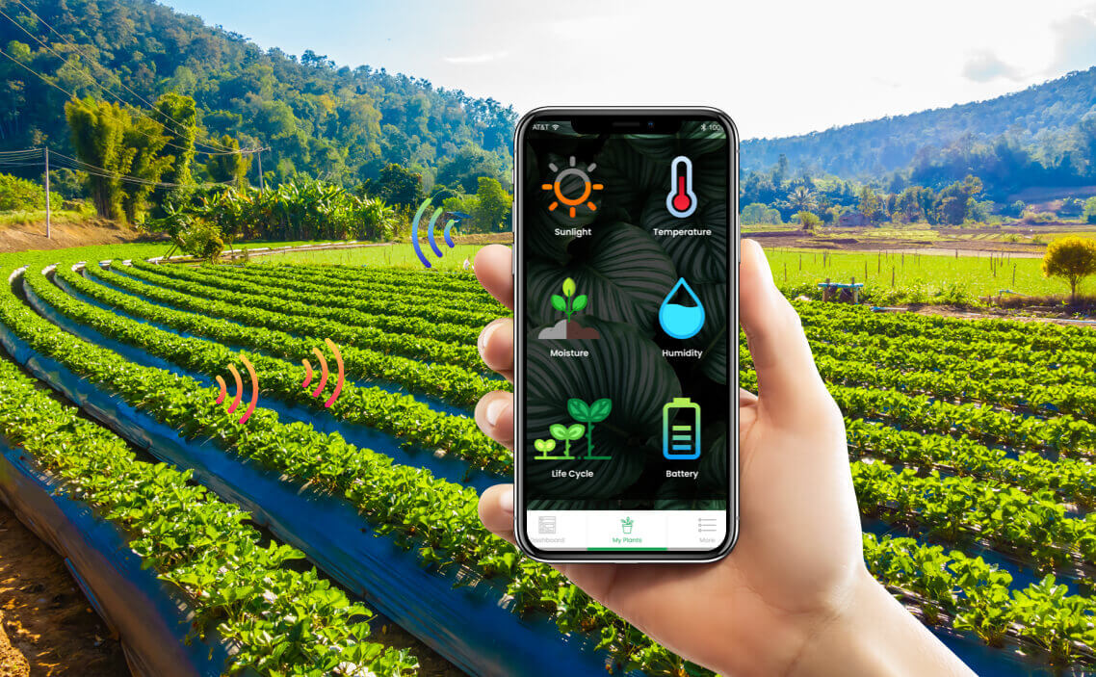
What is IoT Based Smart Agriculture System ?

Slide 3
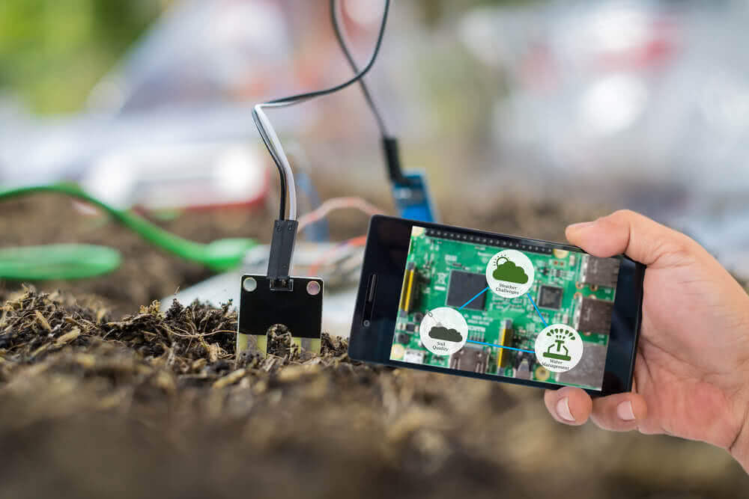
On Field Sensors
Collects Essential On Field Data.

Slide 4
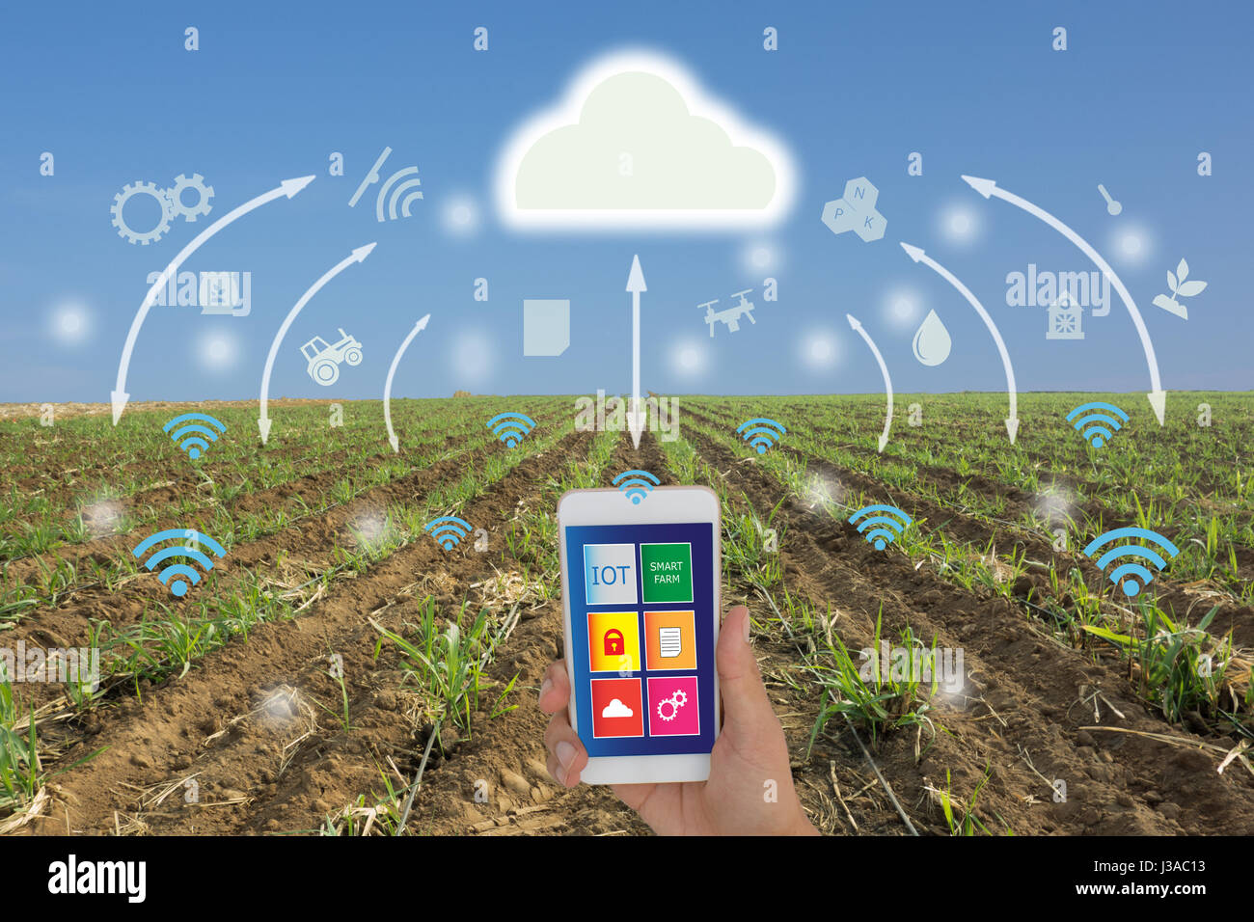
Cloud Storage
Stores the information collected over different sensors before further manipulation.

Slide 5
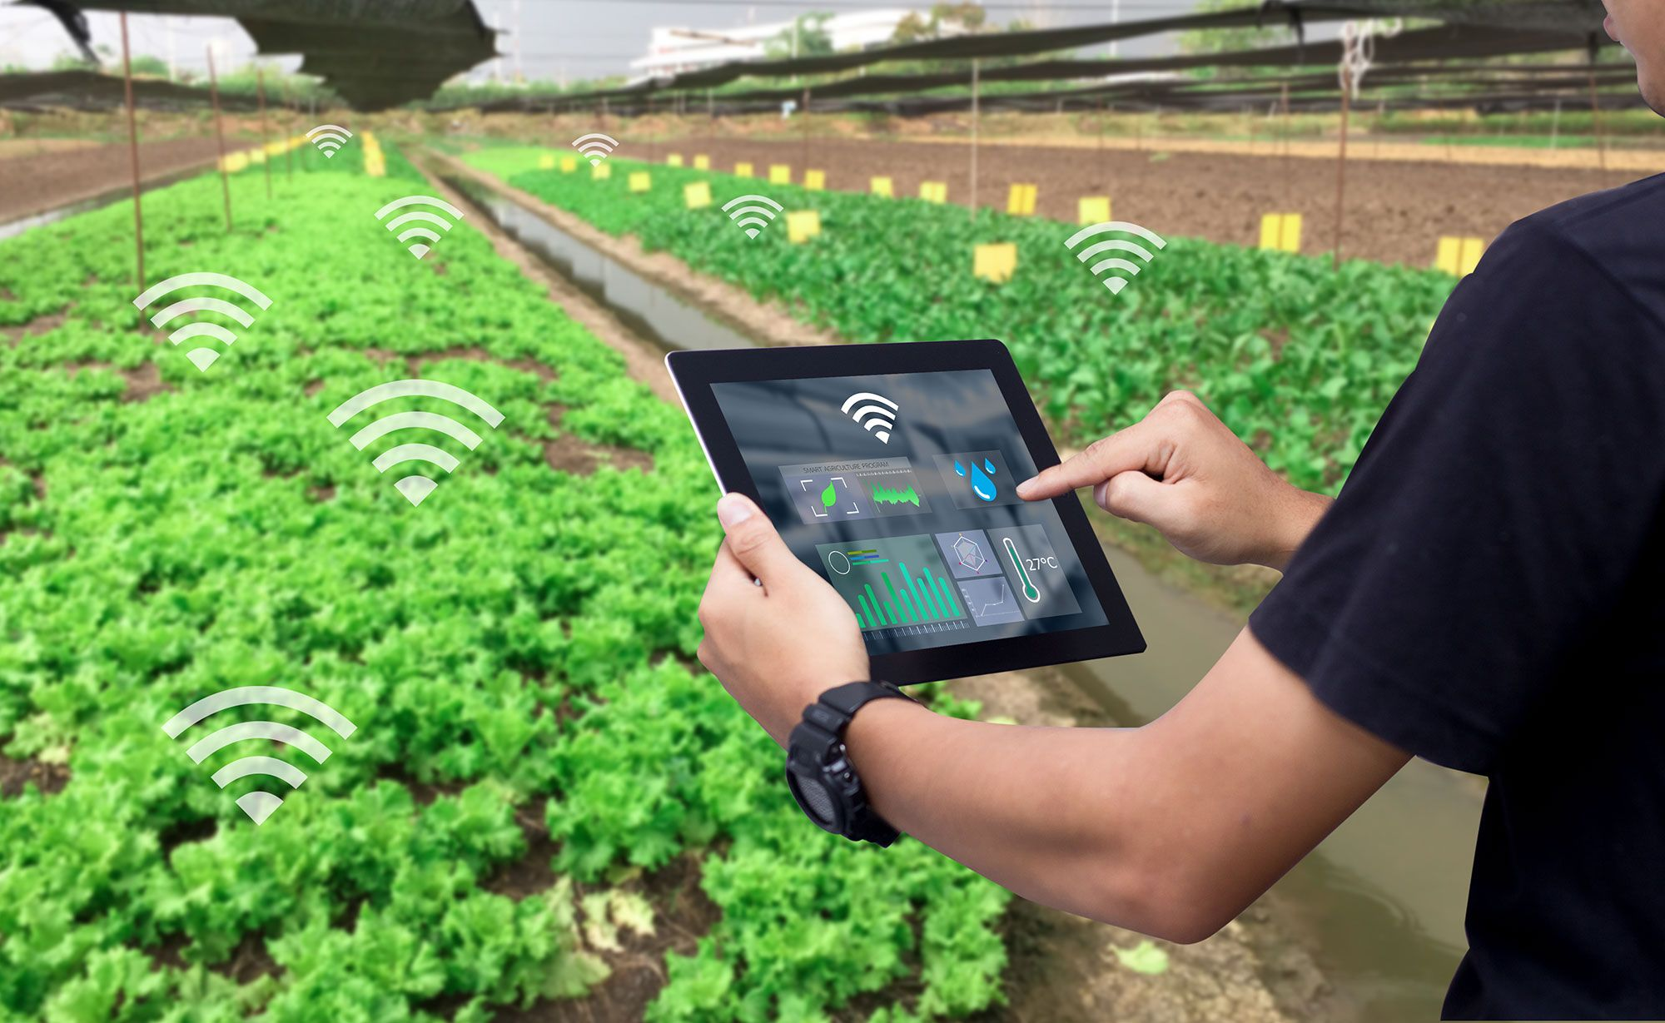
Internet
Connects sensors , storage media & control devices in the network.

Slide 6

Why to switch from conventional agriculture techniques ?

Slide 7
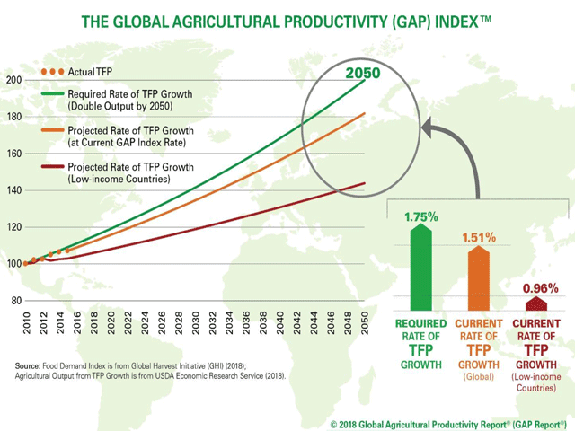
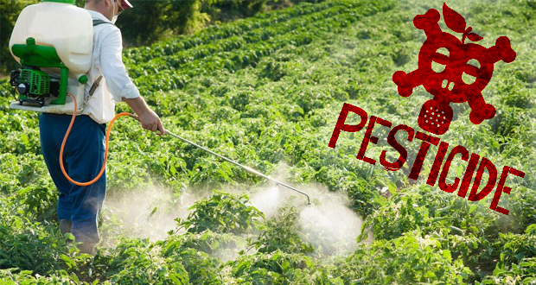
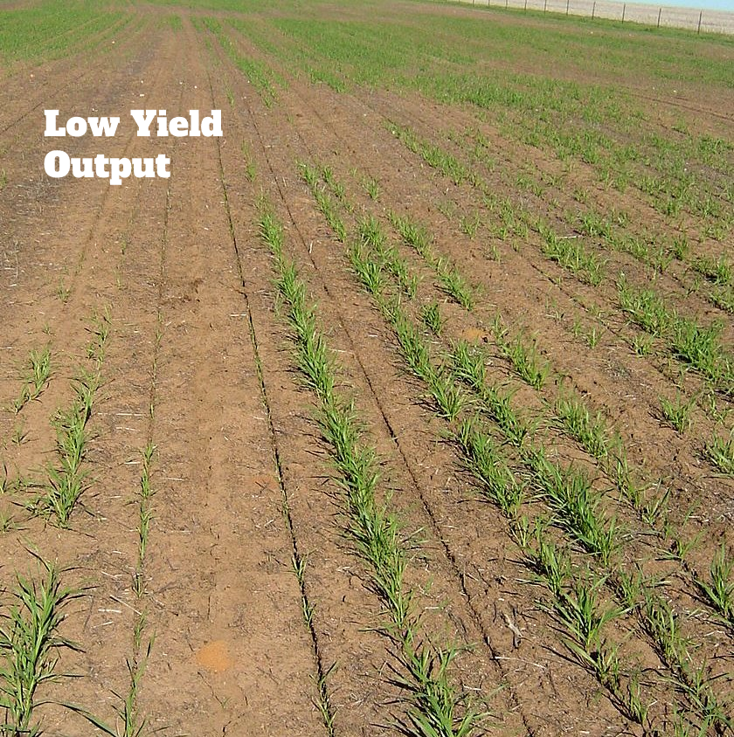
Typical Issues with Conventional Agriculture Methods
Inefficient
Incapable to meet food Demand*
Not very Environmentally Friendly

Slide 8
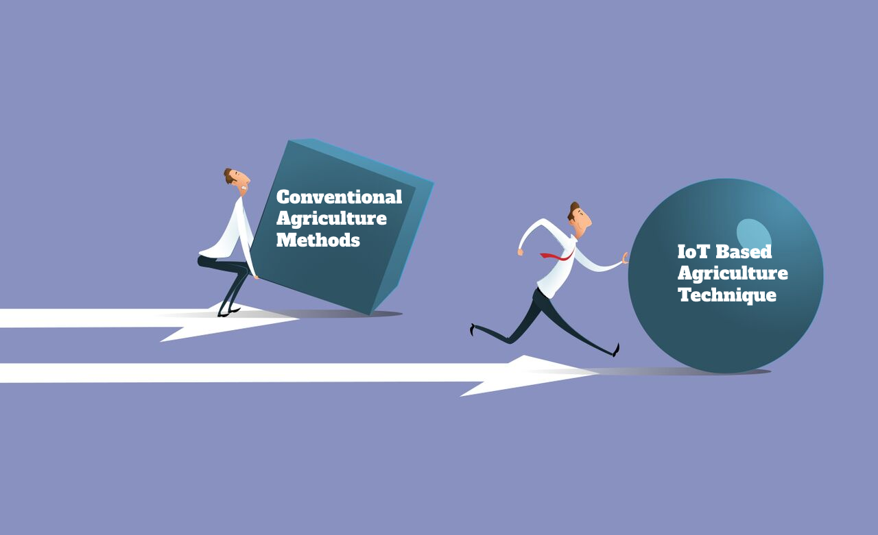
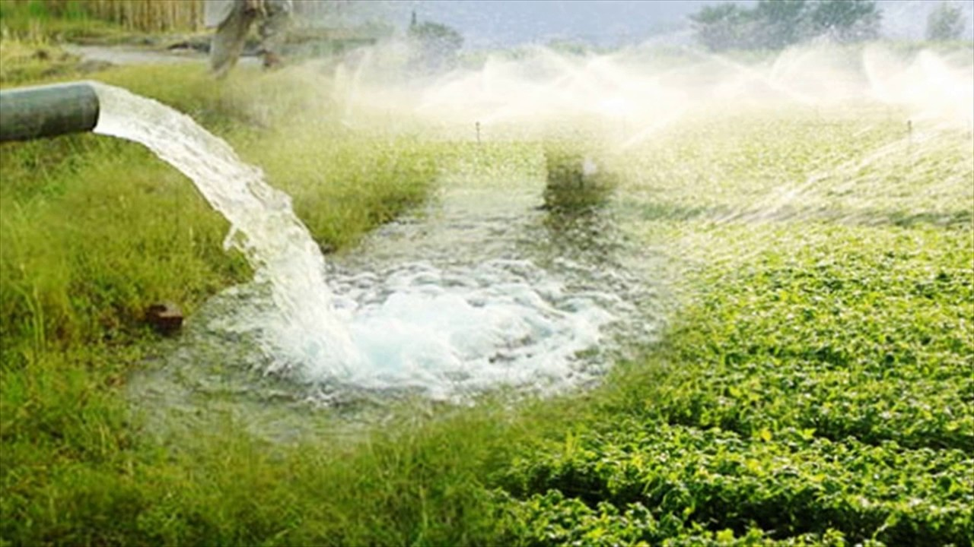
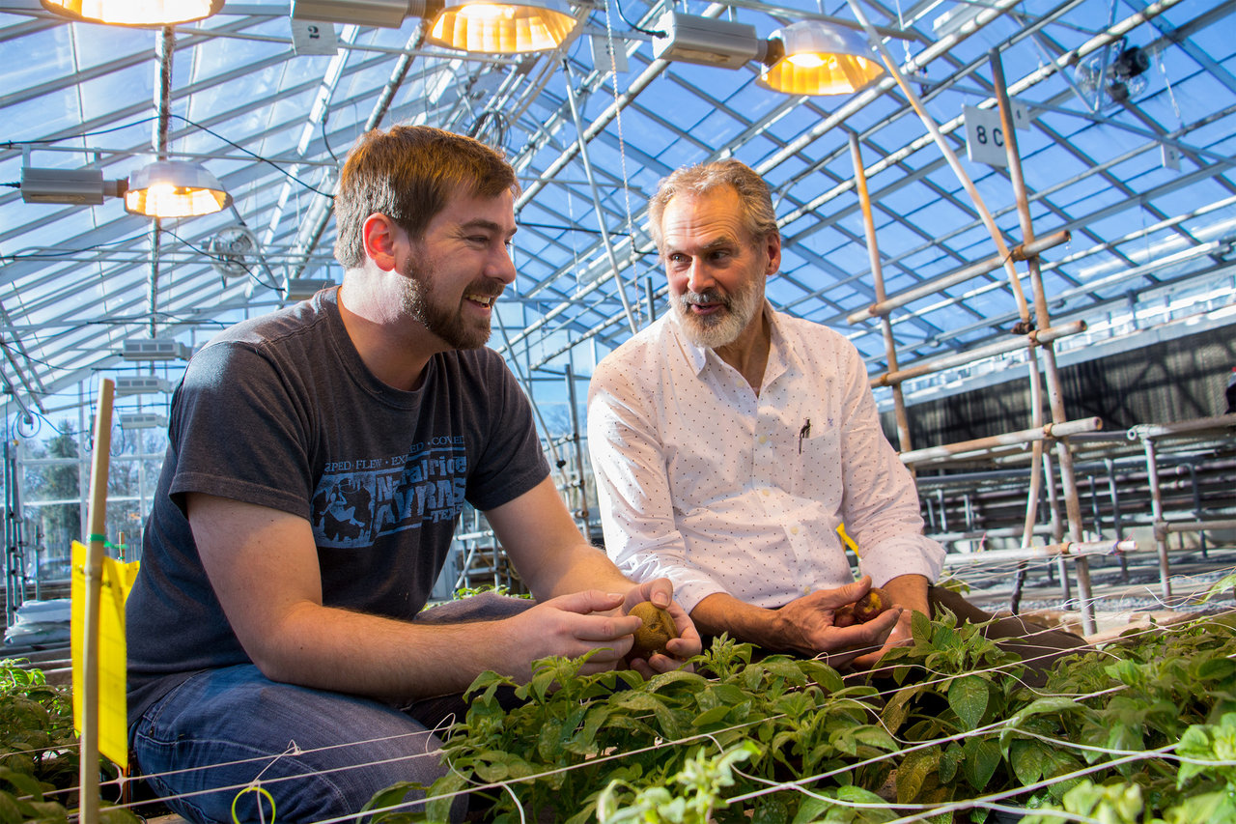

Inefficiency Involved ¹
Cause of Overutilization of resources.
Unable to extract full potential.
Uneconomical.

Slide 9
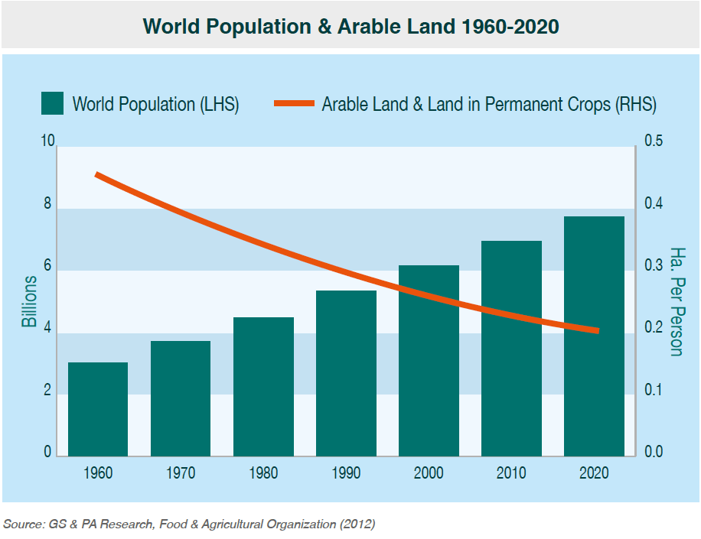
Shrinking Arable Land ²
Available Land Resources are going down
Population Rising swiftly

Slide 10
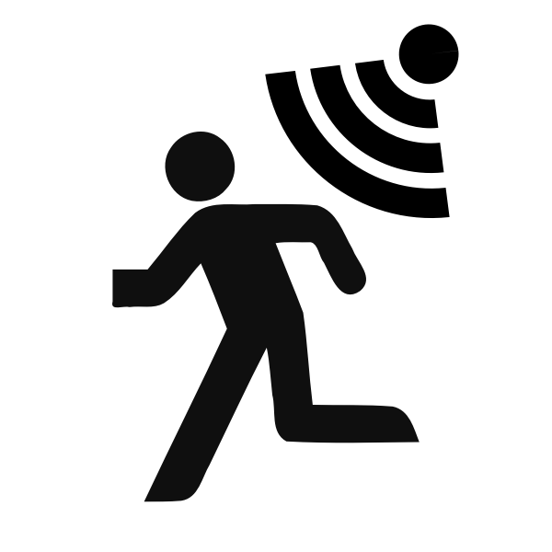
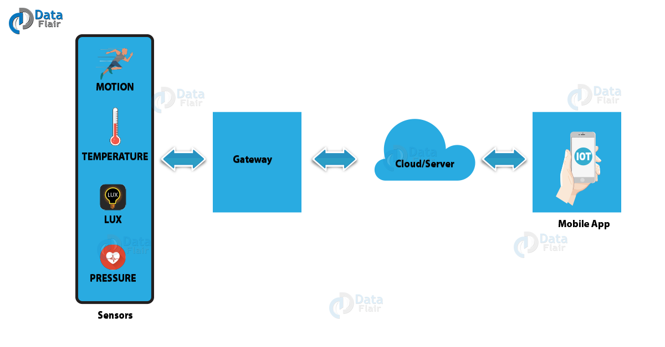
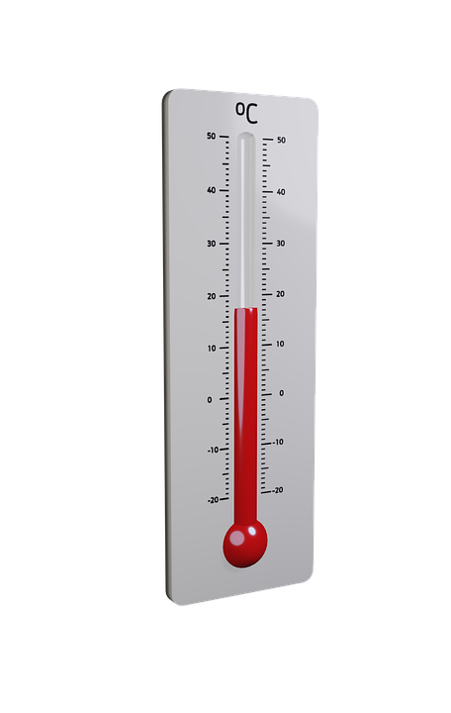
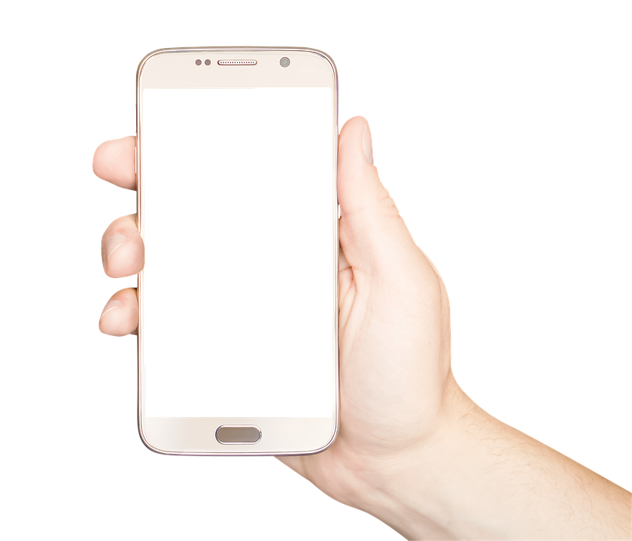
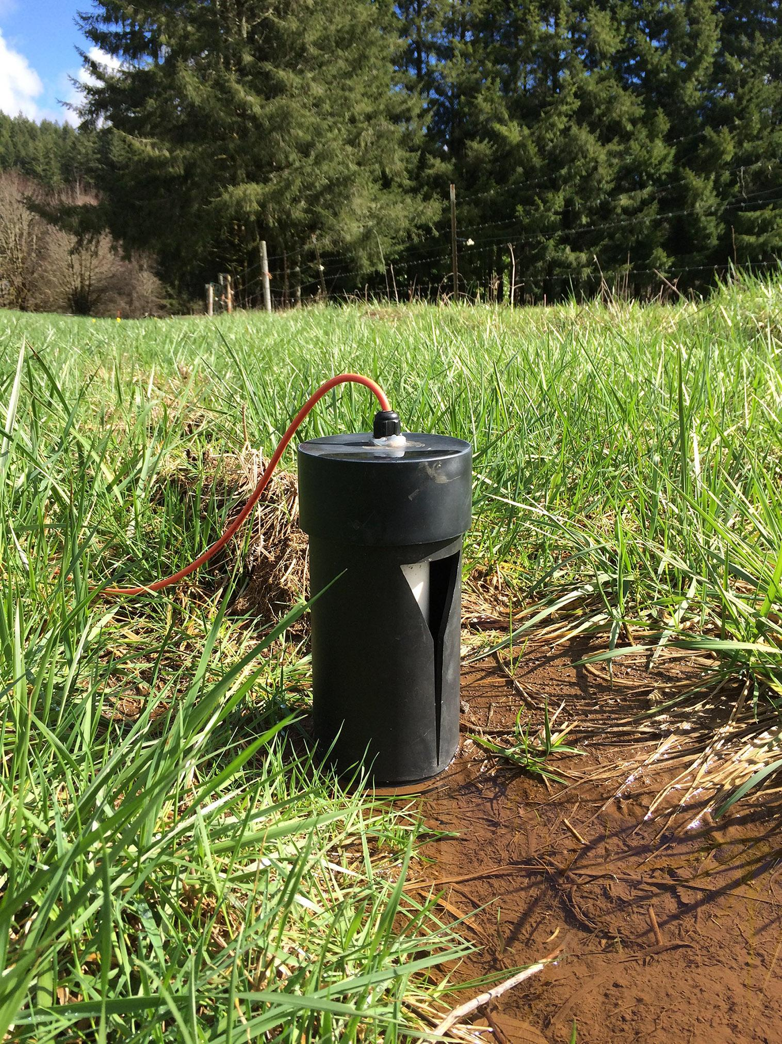
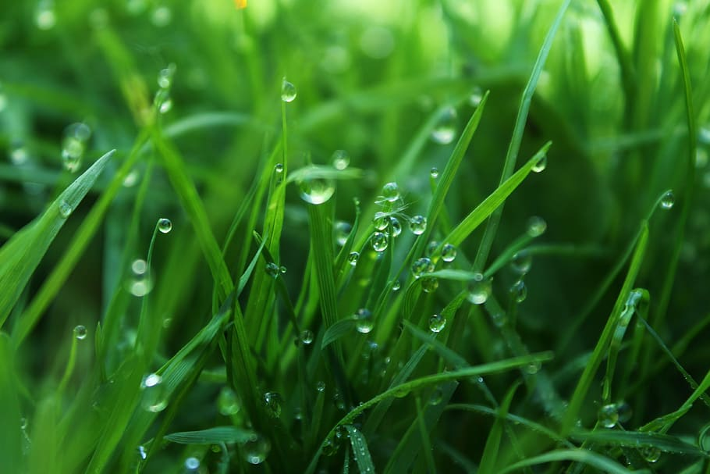
How does IoT work?
MOTION
TEMPERATURE
PRESSURE
HUMIDITY
GATEWAY
Cloud/Server
Mobile App
SENSORS

Slide 11

IoT based Smart Irrigation System

Slide 12
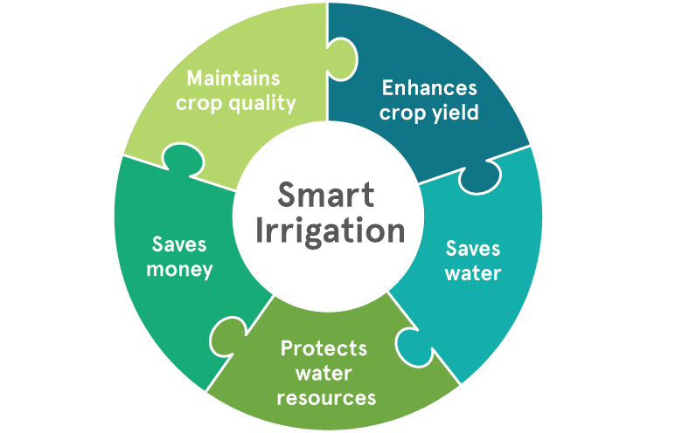
Benefits of using Smart Irrigation system:

Slide 13
IMPLEMENTATION

Slide 14
Main task of our Smart Irrigation System
Automatically irrigate the field depending upon the moisture level in the soil.
Also send the data to the ThinkSpeak server to keep track of land condition.

Slide 15
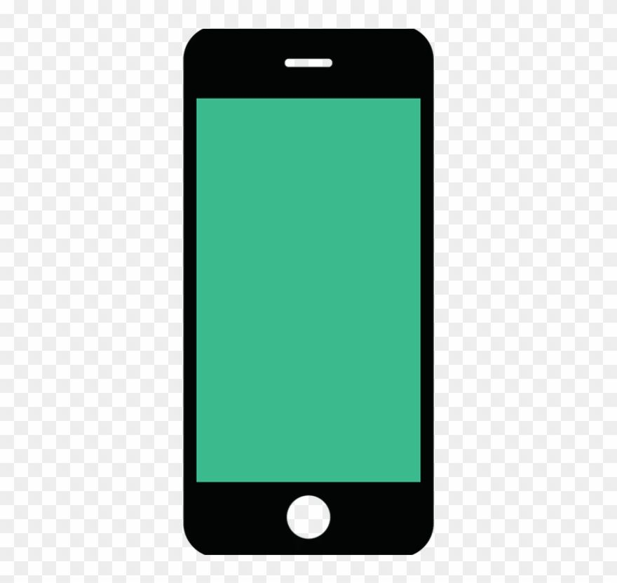
Mobile/ Laptop
LCD Display
ThinkSpeak
Cloud
NodeMCU
Relay
Water pump
DHT11Sensor

Slide 16
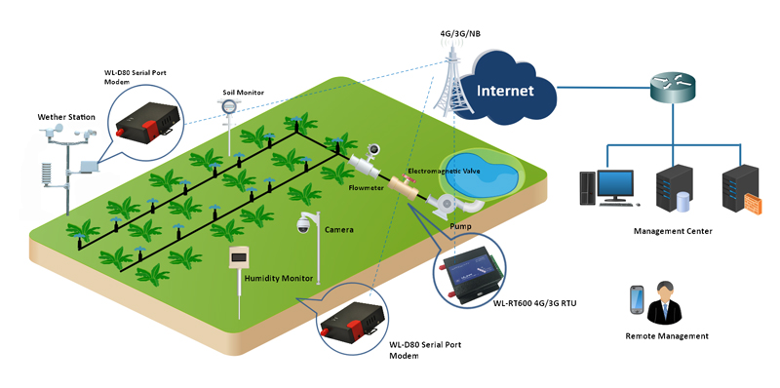

Slide 17
Components Used:
NodeMCU ESP8266
Soil moisture sensor module
Water pump module
Relay
DHT11
Connecting wires

Slide 18
Circuit Diagram

Slide 19
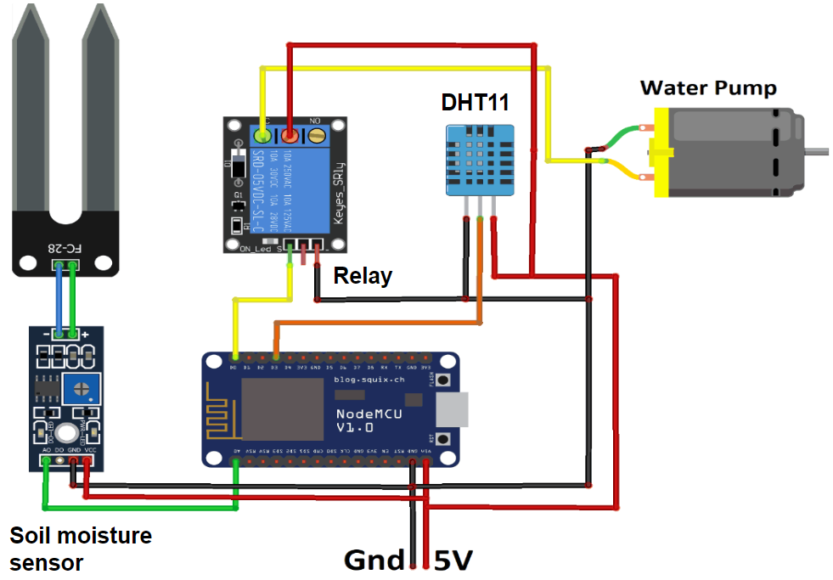

Slide 20
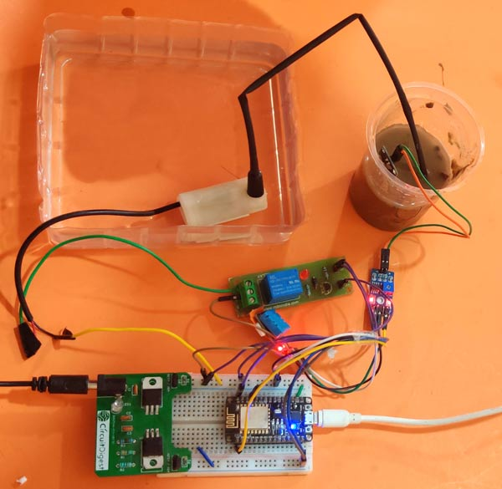

Slide 21
How to calculate Moisture Percentage?
100.00 - (analogRead(moisturePin) * 100.00)
1023.00

Slide 22
Pseudo Code

Slide 23
if(moisturePercentage < 50){
digitalWrite(motorPin,HIGH); // turn on motor pump
}
if(moisturePercentage >= 50 && moisturePercentage <=55){
digitalWrite(motorPin,HIGH); // turn on motor pump
}
if(moisturePercentage > 56){
digitalWrite(motorPin,LOW); // turn off motor pump
}

Slide 24
ThinkSpeak Dashboard View:-

Slide 25
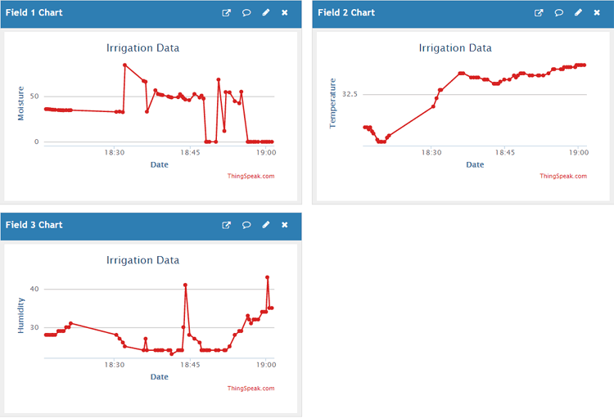

Slide 26
NOTE:
It is important to note that different crops require different Soil Moisture, Temperature and Humidity Condition. We are using such crop which will require a soil moisture of about 50-55%.
MOTOR ON :- MoisturePercentage < 50
MOTOR OFF :- MoisturePercentage > 55

Slide 27
Conclusion & Future Directions
Increase the agricultural productivity
Avoids excessive irrigation, under irrigation, soil erosion and reduces water shortage
Storing the usage data over cloud
Flexibility for new devices and appliances
GPS can be integrated
Speech based option can be implemented with regional language
Single mobile application is enough

Slide 28
Reference
J. Lin, W. Yu, N. Zhang, X. Yang, H. Zhang and W. Zhao, "A Survey on Internet of Things: Architecture, Enabling Technologies, Security and Privacy, and Applications," in IEEE Internet of Things Journal, vol. 4, no. 5, pp. 1125-1142, Oct. 2017 J. Lin, W. Yu, N. Zhang, X. Yang, H. Zhang and W. Zhao, "A Survey on Internet of Things: Architecture, Enabling Technologies, Security and Privacy, and Applications," in IEEE Internet of Things Journal, vol. 4, no. 5, pp. 1125-1142, Oct. 2017
O. Elijah, T. A. Rahman, I. Orikumhi, C. Y. Leow and M. N. Hindia, "An Overview of Internet of Things (IoT) and Data Analytics in Agriculture: Benefits and Challenges," in IEEE Internet of Things Journal, vol. 5, no. 5, pp. 3758-3773, Oct. 2018.
K. V. d. Oliveira, H. M. Esgalha Castelli, S. José Montebeller and T. G. Prado Avancini, "Wireless Sensor Network for Smart Agriculture using ZigBee Protocol," 2017 IEEE First Summer School on Smart Cities (S3C), Natal, 2017
Tzounis A, Katsoulas N, Bartzanas T, Kittas C., "Internet of things in agriculture, recent advances and future challenges". Biosystems Engineering, Vol 164, Dec 2017, Pages 31-48
S. Navulur, A.S.C.S. Sastry, M. N. Giri Prasad, "Agricultural Management through Wireless Sensors and Internet of Things" International Journal of Electrical and Computer Engineering (IJECE), 2017; 7(6) :3492-3499

Slide 29
THE END
Thank you

